Slide 1


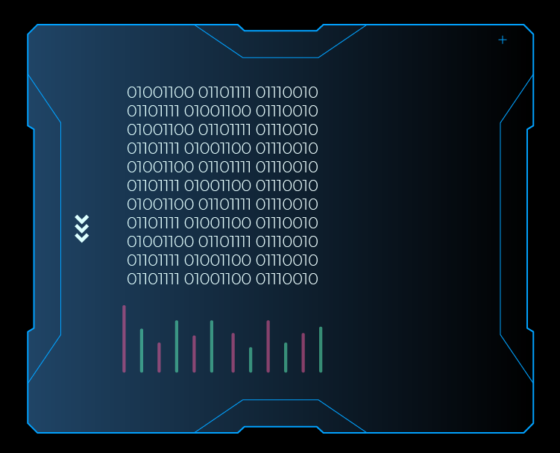
Title:Lightweight Interpretable GNN with API Abstraction for Android Malware Detection
Author: Mushfiqur Rahman ID: 011212083
Institution: United International University
Author: Afsun Al Mayen ID: 011201339
Institution: United International University

Slide 2
Problem Statement
The Problem: Malware is Hiding in Plain Sight
Code Disguising: Malware developers constantly change API names and "scramble" their code to bypass traditional security.
Literal Detection: Existing systems look at exact names (like "sendSMS"). If the name is changed, the system fails.
The Gap: There is a lack of focus on the meaning of the actions, making current antivirus tools fragile and easily fooled by new tricks.

Slide 3
Literature Review
Paper | Contributions | Year | Used Algorithm
GNN-based Android Malware Detection Framework | This framework addresses the problem of advanced hidden malware by extracting deep semantic meanings from code. It treats detection as a graph classification task to capture complex behavioral patterns.Methodology: Uses CodeBERT and TextCNN to create opcode embeddings, which are then processed using GraphSage and SAGPooling on an API call graph. | 2022 | GNN
Exploring GNN-LRP for Android Malware Detection | Focuses on the "Black Box" problem of AI by making GNN decisions interpretable. It identifies which specific code paths or sensitive APIs actually triggered the "malware" label.Methodology: Applies Layer-wise Relevance Propagation (GNN-LRP) to assign scores to nodes and edges within subgraphs generated by the MsDroid framework | 2022 | GNN
NF-GNN: Network Flow Graph Neural Networks | Moves away from looking at code to looking at network traffic. It models the entire communication flow between devices as a graph to detect malicious data-sharing patterns.Methodology: Extracts Network Flow Graphs from traffic data and uses a specialized GNN that treats edge features (connection metadata) as primary data for classification | 2021 | GNN
Ransomware Detection Based on Adaptive GNN Learning | Specifically designed to catch ransomware by identifying "global" relationships between distant API calls. It prevents the model from missing malicious steps that are hidden far apart in the code.Methodology: Utilizes a Text Graph Convolutional Network (TextGCN) with Adaptive Diffusion Convolution (ADC) to automatically learn the best connections between sensitive API nodes. | 2023 | GNN
Network Traffic Graph for 5G Mobile | Targeted at 5G and IoT environments where traffic is dense and complex. it identifies malware by analyzing the structural relationships between different traffic flows rather than just single data packets.Methodology: Converts pcap network packets into vector-based traffic graphs and processes them through a custom Graph Neural Network architecture designed for high-density IoT data. | 2023 | GNN

Slide 4
Gaps in existing research
Existing models focus too literally on API names, making them fragile against modern hiding techniques (obfuscation). Furthermore, current graph-based systems are often too computationally heavy for mobile devices and act as 'black boxes' that fail to explain the behavioral intent behind their decisions.

Slide 5
Gap Analysis
Paper Title | Primary Approach | The GAP | Proposed Solution
GNN-based Android Malware Detection Framework | CodeBERT Semantics | Too heavy for mobile, relies on exact opcode sequences. | Lightweight API Categories (Fast & Efficient)
Exploring GNN-LRP for Android Malware Detection | Explainable AI (XAI) | Uses complex math, hard for normal users to understand. | Behavioral Labels (e.g. "Sends Data to Web") for clear logic.
NF-GNN: Network Flow Graph Neural Networks | Network Flow | Ignores the app's code, only sees data traffic. | Analyzes App Intent before the data is even sent.
Ransomware Detection Based on Adaptive GNN Learning | Global Correlation | Struggles with renamed/hidden API calls (obfuscation). | Abstraction Layer that sees the "meaning" not the name.
Network Traffic Graph for 5G Mobile | 5G IoT complexity | Focuses on environment, not the specific malicious behavior. | Focuses on the Action Flow inside the application.

Slide 6
What’s New? (Our Project Scope)
Our project introduces a Behavioral Abstraction Layer that translates scrambled API names into clear intent categories before they reach the AI. By using a lightweight GNN on these simplified patterns, we achieve a system that is not only harder to fool but also fast enough for mobile devices and easy for humans to understand.

Slide 7
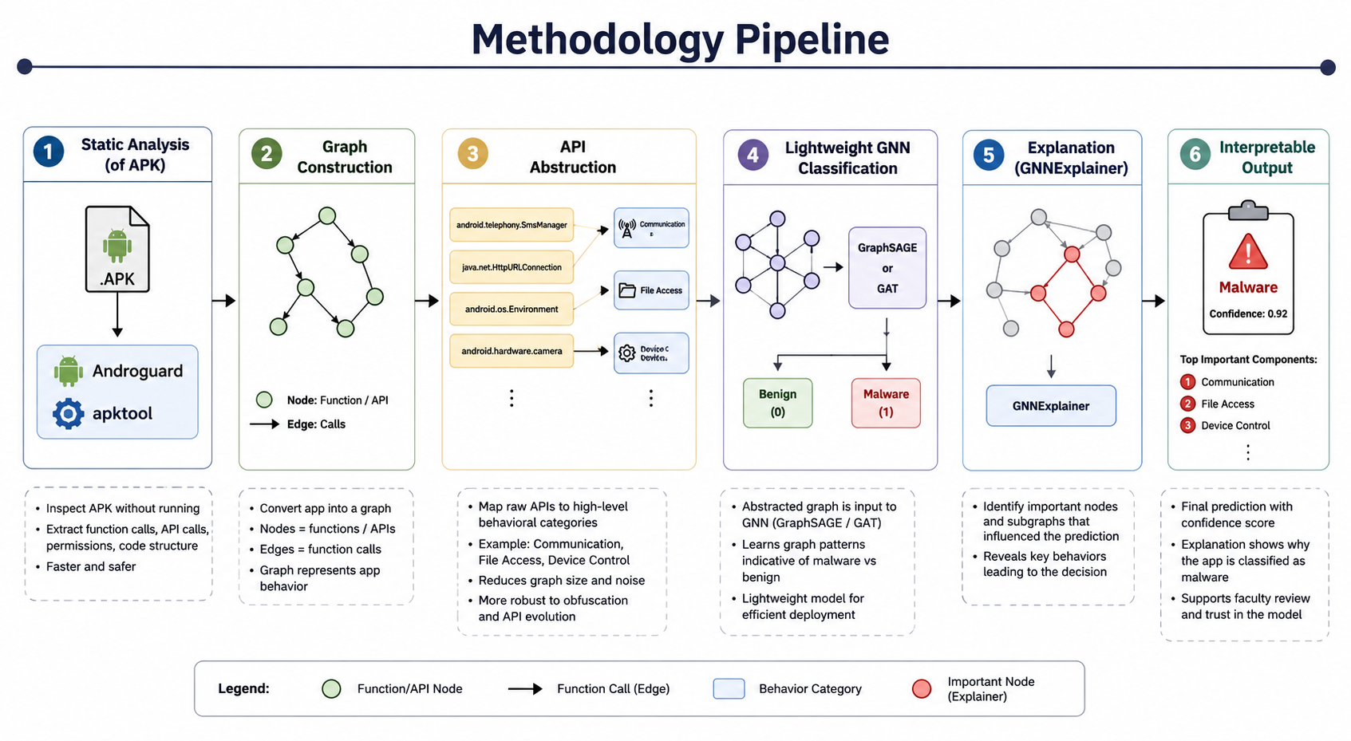

Slide 8
Experimental Setup
DATASETS
MODEL & TRAINING CONFIGURATION
BASELINES & TARGET METRICS
Drebin
Benchmark
Architecture — GraphSAGE + SAGPooling
Baselines compared
Malicious APKs
5,560
GNN layers
3 (GraphSAGE)
Drebin SVM
Traditional ML
Malware families
179
Hidden units
128
MamaDroid RF
Markov chain API
Pooling
SAGPooling (top-K)
GSEDroid
CodeBERT+GNN (SOTA)
AndroZoo
Large-scale
GNN (no abstraction)
Ablation
Total apps
20M+
Hyperparameters
Target metrics
Period
2018–2021
Optimizer
Adam (lr = 0.001)
90–99%
> 0.99
< 3 s
Dropout
0.3
Obfuscation test set
Batch size
64
Accuracy / F1
AUC-ROC
Inference / APK
APKs (ProGuard)
500 malicious
Epochs
100 (early stopping)
> 90%
< 10 MB
Plain
Purpose
Resistance benchmark
Loss function
Binary cross-entropy
Obfuscated acc.
Model size
Explanation type
Data split
80 / 10 / 10 + 10-fold CV
Evaluation Criteria
Accuracy / Precision / Recall / F1
AUC-ROC curve
Obfuscation resistance (ProGuard)
Inference speed per APK
Explainability (7-metric framework)
Ablation: abstraction vs raw API

Slide 9
https://colab.research.google.com/drive/1GPEEAlBjERbu3asVFLdJzjULZb63pq4K#scrollTo=Ln1tH3YIInXu

Slide 10
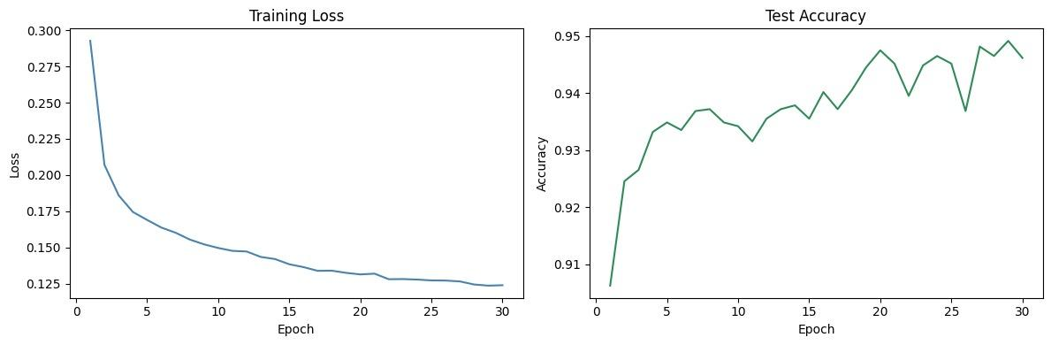
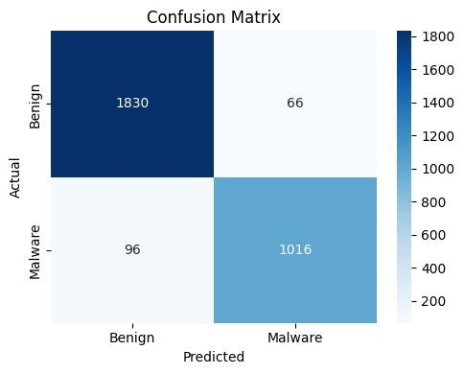
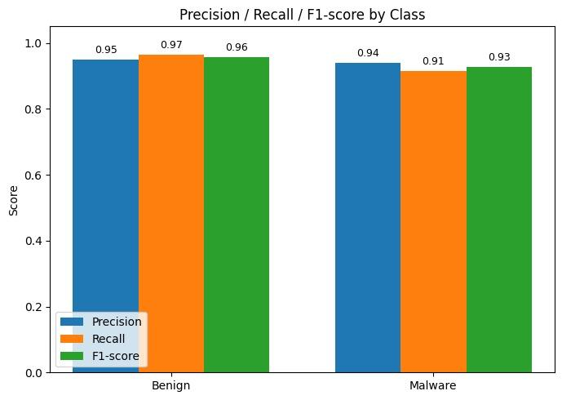
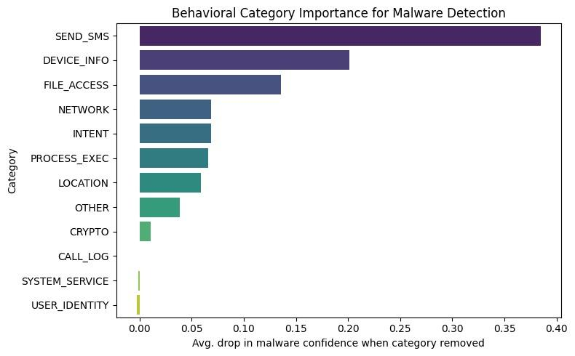
Malware Detection Model — Results
Training Loss & Test Accuracy
Confusion Matrix
Precision / Recall / F1 by Class
Behavioral Category Importance

Slide 11
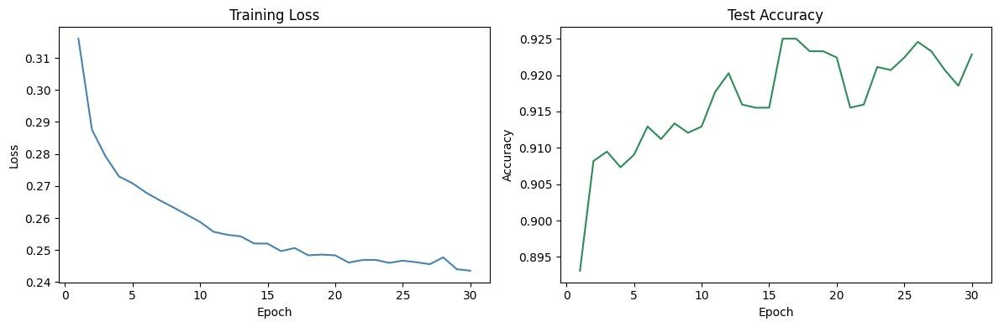
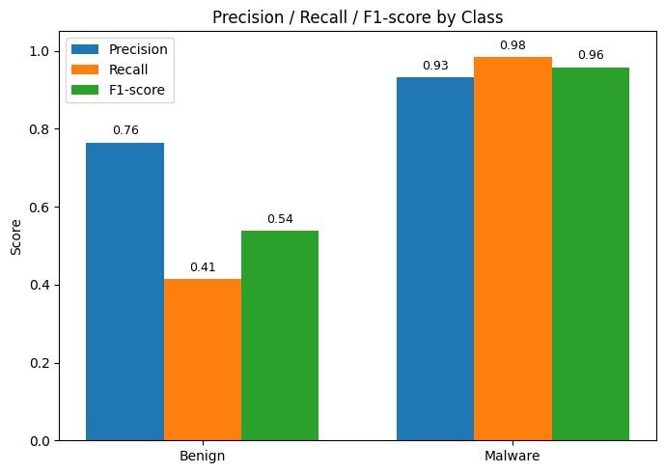
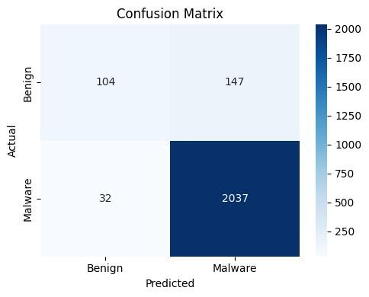
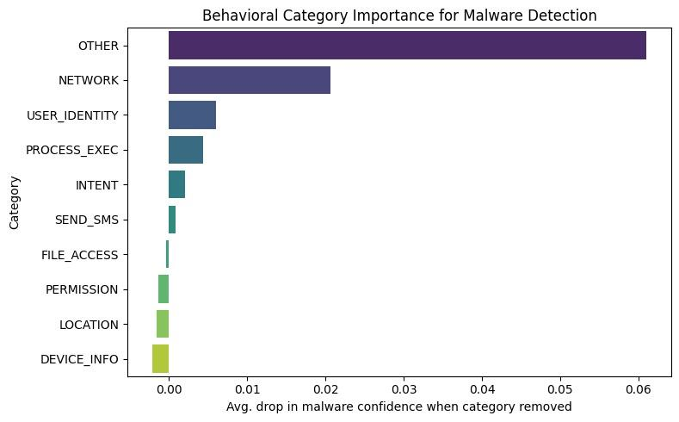
Malware Detection Model — Results
Training Loss & Test Accuracy
Precision / Recall / F1-score
Confusion Matrix
Behavioral Category Importance

Slide 12
Previous Result
Paper Name | Used Dataset | Accuracy
DREBIN: Effective and Explainable Detection of Android Malware in Your Pocket | Drebin Dataset | pre=94%,f1_=91.5, recall=89.8%
Toward Developing a Systematic Approach to Generate Benchmark Android Malware Datasets and Classification | CICAndMal 2020 | pre=85%, recall=88%

Slide 13
Training Performance
Slide 1 of 3
📈 Loss converges smoothly to ~0.24 over 30 epochs · Accuracy stabilizes above 92% from epoch 15+

Slide 14
Class-Level Metrics
Slide 2 of 3
0.93
Malware Precision
Low false positives
0.98
Malware Recall
Catches nearly all threats
0.41
Benign Recall
Key area for improvement

Slide 15
Confusion Matrix
Slide 3 of 3
Pred. Benign
Pred. Malware
Actual Benign
104 (TN)
147 (FP)
Actual Malware
32 (FN)
2,037 (TP)
The model excels at catching malware (98% recall)
but misclassifies 59% of benign samples as malicious.

Slide 16
Behavioral Category Importance
Key Findings
🔵 OTHER behaviors are the strongest signal (Δ0.061)
🌐 NETWORK activity is the #2 predictor (Δ0.021)
👤 USER_IDENTITY & PROCESS_EXEC rank 3rd and 4th
📍 LOCATION & DEVICE_INFO contribute the least

Slide 17
Discussion
✅ Strong Malware Detection
⚠️ High False Positive Rate for Benign Apps
With 98% recall and 0.96 F1-score, the model reliably identifies malicious apps — critical for a security-first deployment where missing threats is costly.
Only 41% recall on benign samples means 59% of clean apps are flagged as malware. This creates friction for end users and may reduce trust in the system.
🔍 Feature Signal Concentration
📉 Training Stability
The OTHER category drives the largest confidence drop (Δ0.061), suggesting the model relies heavily on unstructured behaviors — a potential blind spot if adversaries mimic benign patterns.
Accuracy oscillates between 91–92.5% in later epochs. Early stopping or learning rate scheduling may help stabilize convergence and improve benign recall.

Slide 18
Conclusion
The behavioral neural network achieves strong overall performance but requires targeted improvements to benign classification before production deployment.
01
Production-Ready Malware Recall
98% recall means near-complete threat coverage. The model is ready to serve as a first-line malware detector.
02
Benign Classification Needs Work
Improve benign recall (41%) via class-weighted loss, threshold tuning, or additional benign training data.
03
Prioritize Network & OTHER Features
Focus feature engineering on the two dominant categories, which together account for ~80% of model signal.
04
Next Steps
Run ablation studies on OTHER, apply early stopping, and evaluate on adversarial/obfuscated malware samples.

Slide 19
Thank You

